Slide 1

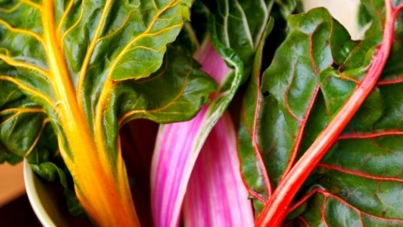


Battle of Neighborhoods – Food Truck Edition
Applied Capstone Project
-Varun Duvalla

Slide 2
problem
Suggest top three neighborhoods to kick start a middle eastern cuisine food truck business
Target customers
Schools
Universities
Offices
Shopping Malls
Try to avoid the concurrences of other food trucks from other competitors

Slide 3
Data acquisition and cleaning
Sources:
http://www.city-data.com/nbmaps/neigh-Houston-Texas.html
Foursquare data to find popular venues
How will the data be used to answer the business needs?
The data mentioned above will be used to explore and target locations across different venues present in the neighborhoods.
1. Use Foursquare and geopy data to map top venues for the super neighborhoods of Houston and cluster them in groups
2. City-Data to get the neighborhoods information
3. Additional data will be added from open data sources if available in the future if the data is insufficient
Cleaned data consists of 85 neighborhoods along with their latitude and longitude

Slide 4
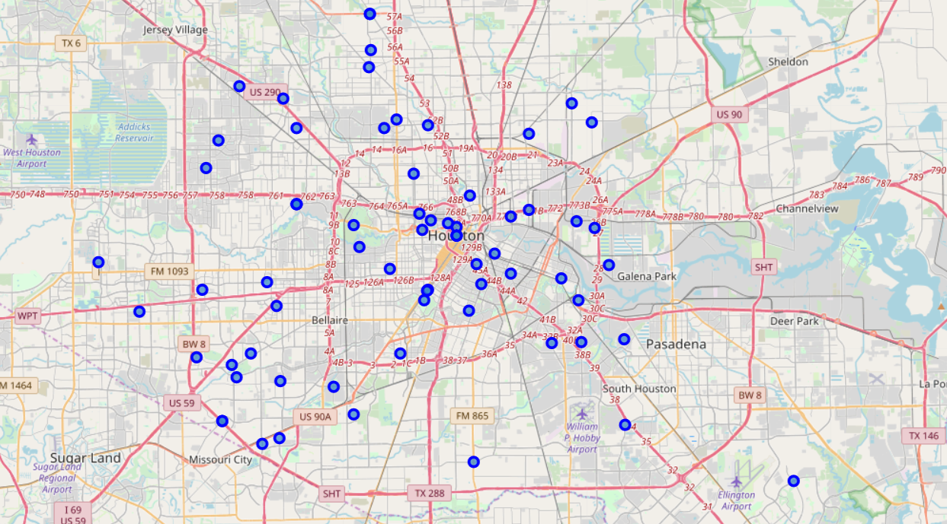
Map of Houston’s Super Neighborhoods

Slide 5
MEthodology
Map venue categories Food Trucks, Schools, Universities, Offices, and Shopping Malls
Assign each venue category weights and calculate a weighted score by creating a matrix
Sort it by descending having the highest score at the top

Slide 6
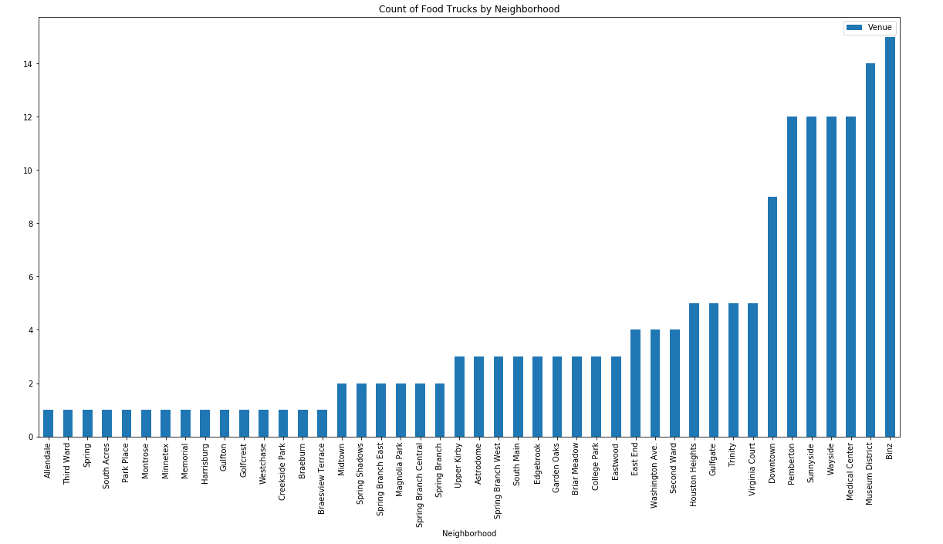
Food truck per each neighborhood
Visually we show that the count of food truck are high in the following neighborhoods,
Binz
Museum District
Medical Center

Slide 7
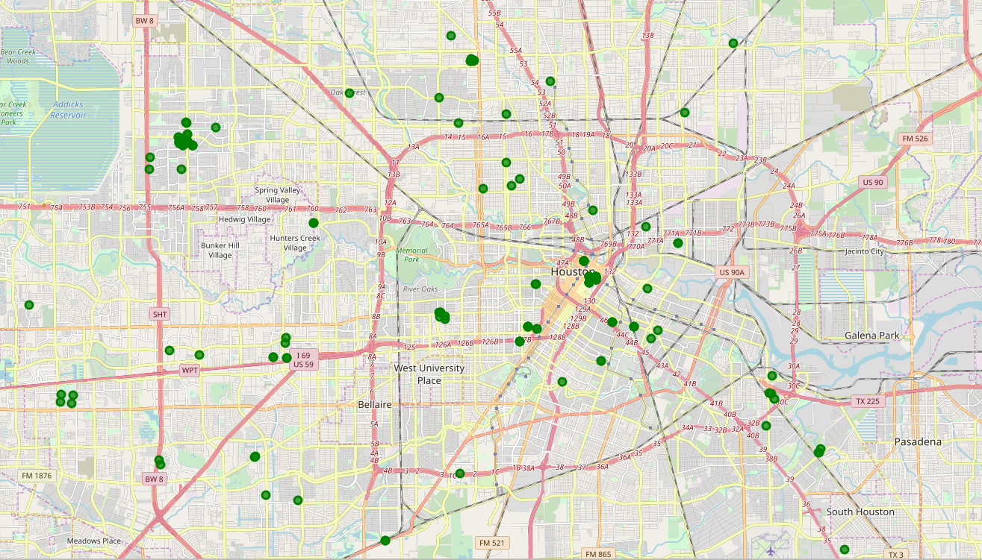
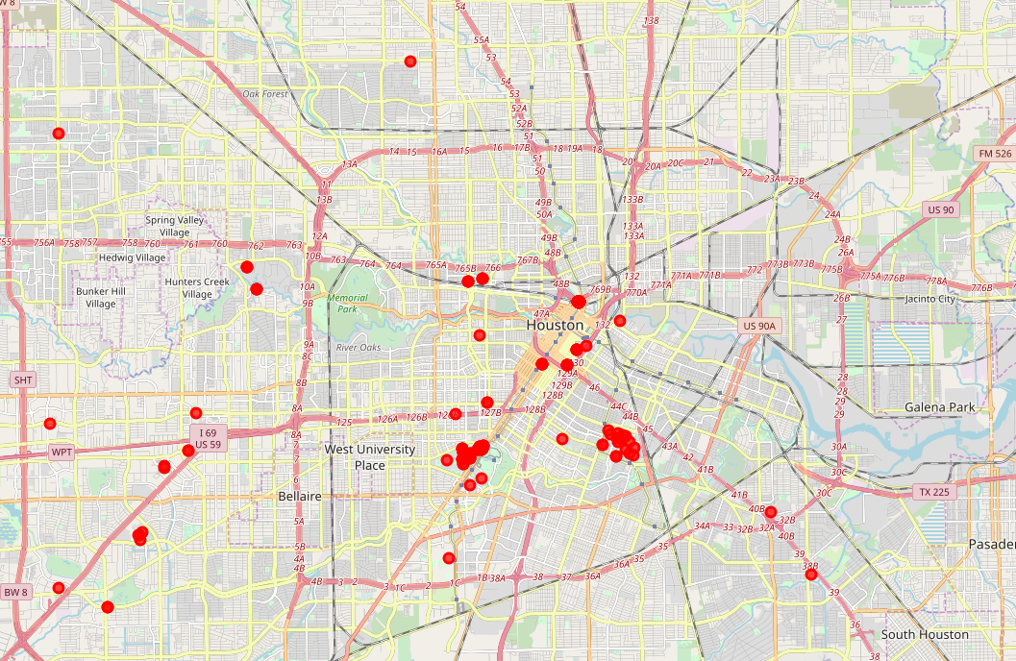
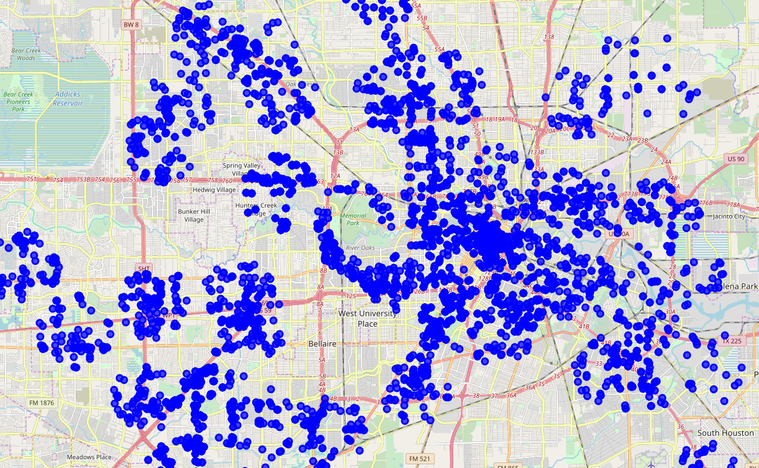
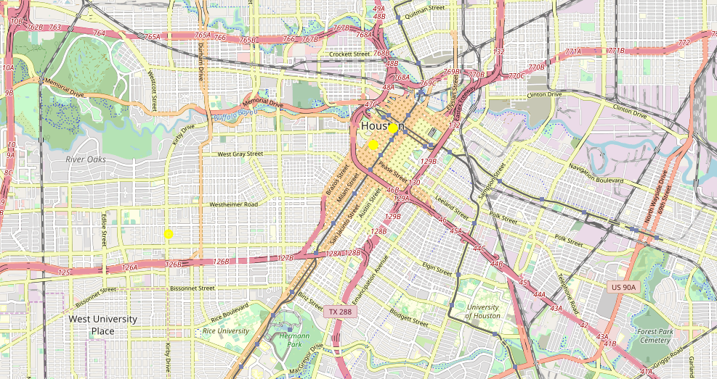
Plotting Venue categories
Map of Schools in the Houston Neighborhoods plotted in green
Map of Universities in the Houston Neighborhoods plotted in red
Map of Offices in the Houston Neighborhoods plotted in blue
Map of Shopping Malls in the Houston Neighborhoods plotted in yellow

Slide 8
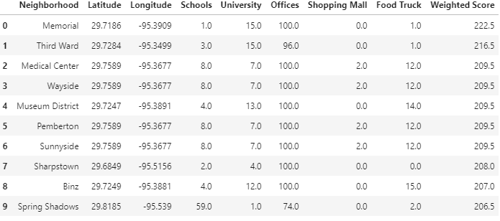
From previous slide we get a visualization of count of venues which are closer to the downtown are the high comparatively to the outskirts of the downtown which is an expected result.
Weights are assigned to each venue category, Food Truck being in negative since we need to avoid the concurrences of other food trucks, positive values for the other categories since they are the target audience. Offices have high weights than the other categories since they would be the prime target for this business.
Performing calculation using the formula below,
x = (y * i) + (y1 * i1) + ........... + (n * m)
we calculate the weighted score for each neighborhood by creating a weighted matrix as shown below.

Slide 9
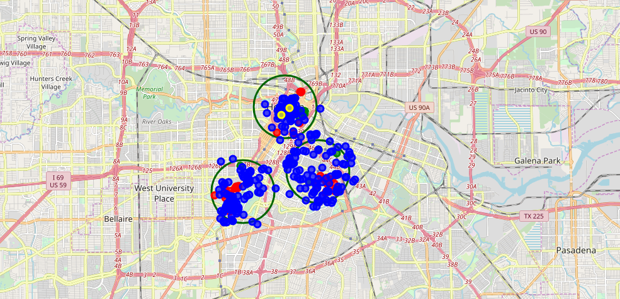
results
After the analysis and calculations we can observe the top three neighborhoods in Houston to start are food truck are,
Memorial
Third Ward
Medical Center
Map of Top three neighborhoods in the Houston encircled within the green circle

Slide 10
Conclusion
Based on our analysis the client should start their food truck business in the following three neighborhoods,
Memorial
Third Ward
Medical Center
Upon further analysis, the client can also do business in the next three neighborhoods,
Wayside
Museum District
Pembertown
Limitations,
Geopy could not yield the results for all the super neighborhoods in Houston which were excluded from the data and few of the other neighborhoods have the same co-ordinates which could mean that the neighborhoods are close to each other or the Geopy is producing faulty co-ordinates
Accuracy of venues purely depends on Foursquare

